Slide 1
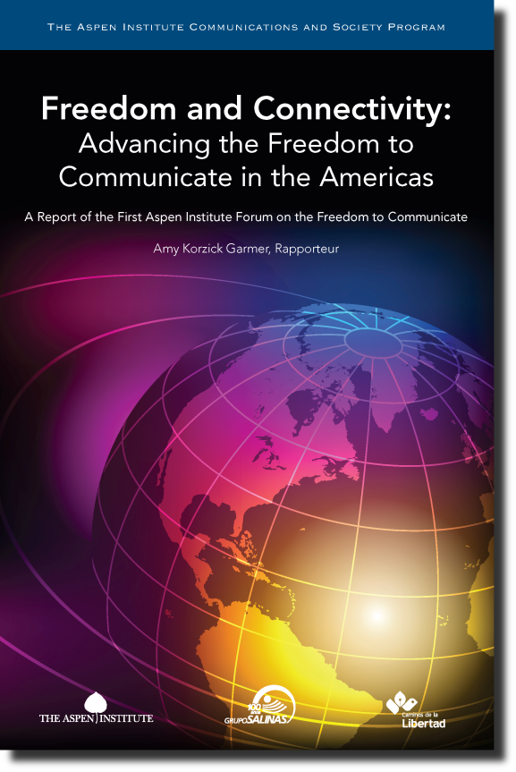
Report of the Aspen Institute Forum on the Freedom to Communicate
by Amy Korzick Garmer
www.aspeninstitute.org/freedom2c
Twitter: #freedom2c

Slide 2
Eight Major Barriers to Connectivity and the Freedom to Communicate in Mexico
Lack of Infrastructure
Lack of Political Consensus
Insufficient Telecommunications Investment
Lack of Competition
Cost of Service

Slide 3
Major Barriers to Connectivity and the Freedom to Communicate cont’d.
Legal Issues
Social and Cultural Barriers
Direct and Indirect Censorship
Notes:
Legal Issues: Digital presents new challenges in the area of law. Forum participants
Social and Cultural Issues: Cognitive gaps and lack of educational opportunity create barriers to connectivity.
Digital inclusion goes beyond physical connections to technology or a network. People need tools, skills and understanding to use information effectively—people need digital and media literacy. Without ability to develop these skills in schools, libraries, community centers, etc., too many people will remain disconnected.

Slide 4
Recommendation: Develop a national consensus and plan for the digital society in Mexico
Make telecommunications one of the top items in the national agenda.
Create a national campaign to drive investment and engagement in the digital society.

Slide 5
Recommendation: Develop the digital infrastructure
Improve markets by promoting competition and rejecting discrimination.
Where markets fail, government has a role to subsidize investment to spur the development of broadband infrastructure.
Targeted investments can help, but government should first do no harm.

Slide 6
Recommendation: Develop a culture of innovation
Recommendation: Develop an ecosystem for investment in innovation
Invest in human capital – innovation springs from knowledge, creativity, talent of people
Nurture innovation where curiosity, inquiry and experimentation thrive: universities, cultural institutions, corporate R&D centers
Access to capital in formative stages of development is critical

Slide 7
Recommendation: Develop an enabling environment for freedom and connectivity
Preserve a Free Press and the Freedom to Communicate.
Reject censorship, including overly broad legislation and policies that hamper an open Internet.
Re-evaluate the 2007 electoral reform law.
Complete enactment of a constitutional amendment giving the Federal Government the authority to investigate violent crimes against journalists and fully fund implementation and enforcement of this authority.
The media can help themselves by adopting voluntary internal codes of conduct that minimize the sensationalism of reporting on violence in Mexico without compromising the principles of good journalism.
Develop legal structures for freedom.
Adopt new paradigm thinking.
Embrace a multi-stakeholder approach to Internet governance.
Overcome cultural barriers by working together.

Slide 8
Report of the Aspen Institute Forum on the Freedom to Communicate
by Amy Korzick Garmer
www.aspeninstitute.org/freedom2c
Twitter: #freedom2c

