Slide 1
Lessons for Communities Isen – “Salter, you got anything for us?” Salter – “No” Isen – “Good, Come share that with us”
James Salter, President

Slide 2
1st FTTH Build – Began in 2001
Borough of Kutztown, PA (3,000 Homes)
32nd FTTH Build – 2012
Google Fiber, Kansas City (More than 3,000 Homes)

Slide 3
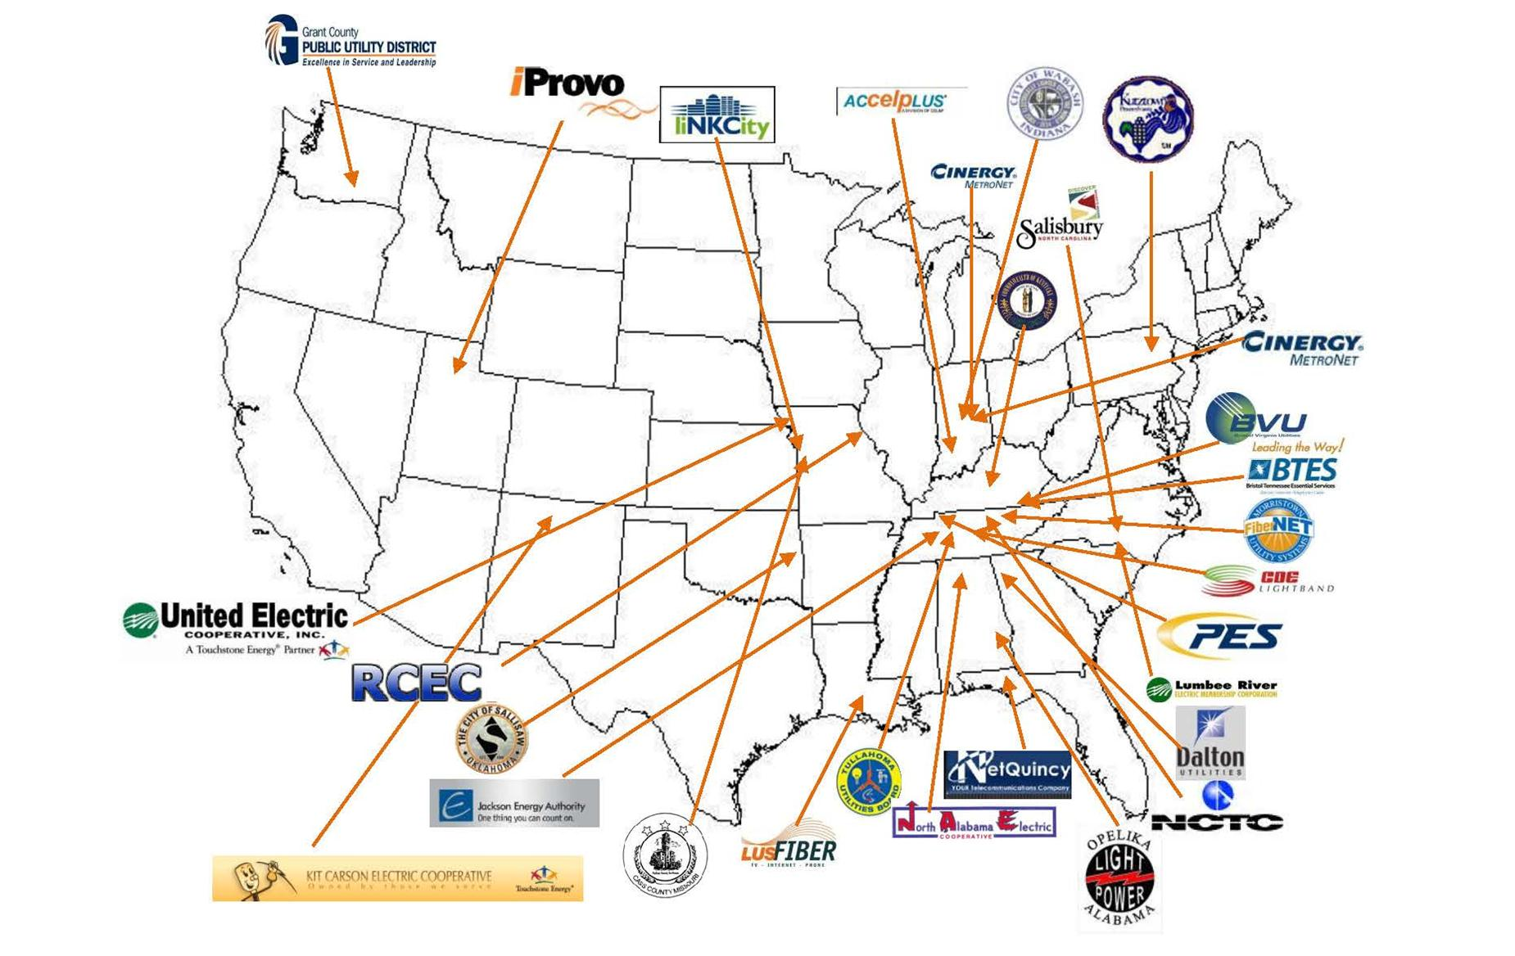
Our FTTH Footprint

Slide 4
Up to now, I’ve only had 4 Ideas, and I’m not sure any were original?
The Demand for Bandwidth Will Not End
Fiber is the only answer to bandwidth
If a Community believes they need bandwidth, they should build it themselves
Open Access won’t work in US model

Slide 5
My 5th Idea….
US is 15% built with FTTH
US should be 100% built with FTTH
Electric Utilities should build, or at worst partner, on the remaining 85%

Slide 8
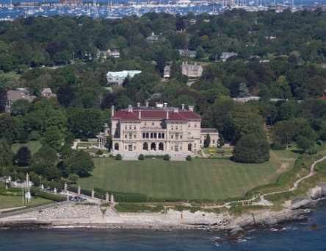

Slide 9
Why Electric Utilities?
Don’t believe Major ILEC’s nor MSO’s will significantly ramp FTTH builds – wireless is king
Biggest hurdle to FTTH build is access to ROW – electric utilities own 80% of easements in US

Slide 10
Our FTTH Footprint

Slide 11
Why Electric Utilities?
Don’t believe Major ILEC’s nor MSO’s will significantly ramp FTTH builds – wireless is king
Biggest hurdle to FTTH build is access to ROW – electric utilities own 80% of easements in US
Second biggest hurdle to FTTH is recovering cost in lower density areas – electric utilities can significantly close that financial gap IF they ACTUALLY implement REAL SmartGrid

Slide 12
Utility Capital Investment Per Customer…...
$2,500
$2,620
$3,140
$10,500
$13,470
$14,100

Slide 13
What is total investment in Electric system?
Transmission = $1,500/Customer
Generation = $7,500/Customer
Distribution = $3,500/Customer
TOTAL INVESTMENT = $12,500 PER CUSTOMER
Or $1,750,000,000,000 !!!

Slide 14
Total Generation Capacity in USA – 900,000 MW
Average Generation Needed in USA – 450,000 MW (50% Load Factor)

Slide 15
Typical Daily Residential Usage - Summer
Peak Generation
@ 10 cents/KWH
Intermediate Generation
@ 5 cents/KWH
Base Generation
@ 2 cents/KWH

Slide 16
Cost of New Generation?

Slide 17
Why aren’t Electric Utilities with me on this?
They don’t have any regulatory incentive to do real SmartGrid – they get a return for a new coal plant, they don’t get a return for technologies that avoid a new coal plant - We must change politics of regulation
They don’t believe you need big data requirements to do SmartGrid – We must show them they are shortsighted – Ask Chattanooga
They don’t want to be in the retail telecom business and they don’t want to partner with anybody – We must convince them that cyber security and common infrastructure aren’t mutually exclusive

